Slide 1
Machine Learning Bootcamp IDUG NA 2019: June 6, 2019 Mark Ryan Jason Shayer Steve Darling
Notes:
Artificial Intelligence (AI) is the broadest concept of machines being able to carry out tasks that mimic human capabilities:
Once such a capability has been mastered it may no longer be called AI e.g. Deep Blue’s win against world champion chess player Garry Kasparov in 1996.
Examples of AI at the time of unveiling: IBM’s Watson win at Jeopardy in 2011
Google’s AlphaGo win against top Go players in 2016 are good examples of significant AI achievements.
Reasoning, planning, and natural language understanding are AI capabilities.
Machine Learning (ML)
an AI capability based around the idea that we should be able to give machines access to data and let them learn for themselves
a machine “learns” if it gets better at performing a specific task as it gains experience.
For instance, an email spam detector might get better at differentiating between valid emails and spam by “learning” from emails that are discarded as spam.
Deep Learning (DL)
a class of machine learning algorithms that produce models composed of deep neural networks
Compared to non-DL, or classical ML algorithms, DL achieve world-class performance in a set of important applications, including image recognition and machine translation
Take the same “secret sauce” that makes common classical ML algorithms work (defining a loss function to describe the delta between the actual outputs of a given set of inputs and the predicted output from the model; and using derivatives of that loss function to determine how to update weights in the model to minimize the loss function and thus maximize the accuracy of the prediction) and generalize it to work across multiple layers of weights
You are sitting here today because of the accomplishments of deep learning – classical ML continues to provide value in many applications and has important advantages (including requiring less data and being much more explainable), but the breakthroughs, headlines, promise and concern is because of deep learning
The starting gun of the deep learning revolution was in 2012 when a team using a deep learning approach achieved a result on Imagenet (an image recognition challenge) that was an order of magnitude better than what had been accomplished up to that point
While the math behind deep learning is decades old, the flashpoint was only 7 years ago, and it’s only in the subsequent 5 years or so that the combination of stable usable frameworks, cheap (especially cloud) hardware, and accessible learning materials has made DL of interest to non-specialists

Slide 2
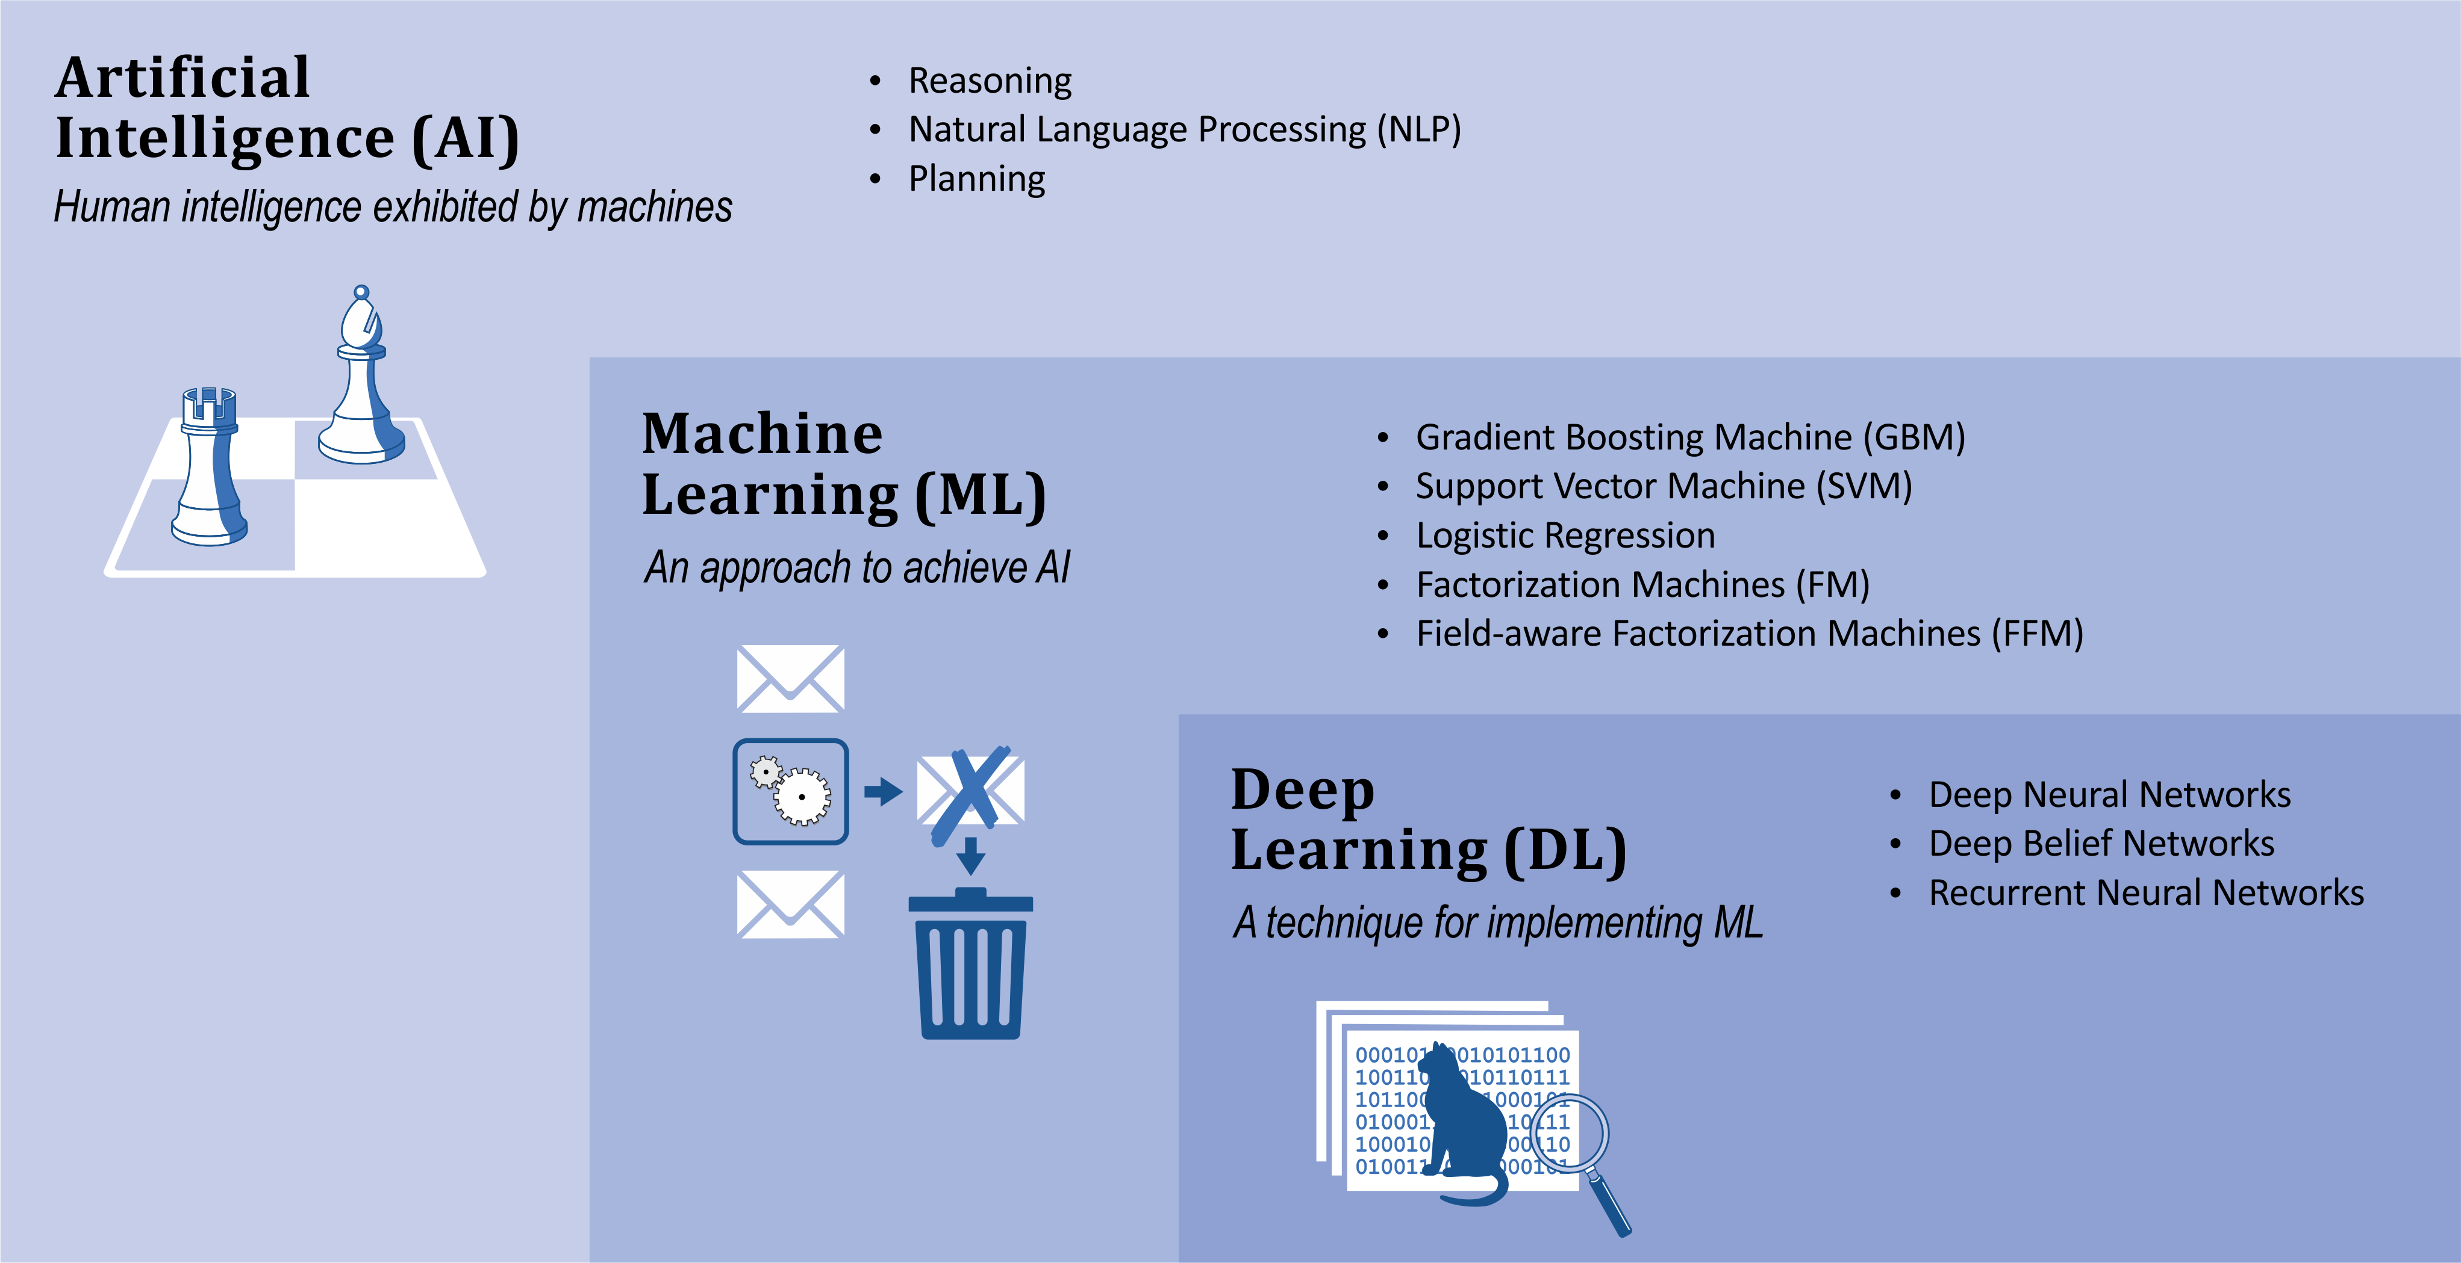
What is Machine Learning?
Notes:
Artificial Intelligence (AI) is the broadest concept of machines being able to carry out tasks that mimic human capabilities:
Once such a capability has been mastered it may no longer be called AI e.g. Deep Blue’s win against world champion chess player Garry Kasparov in 1996.
Examples of AI at the time of unveiling: IBM’s Watson win at Jeopardy in 2011
Google’s AlphaGo win against top Go players in 2016 are good examples of significant AI achievements.
Reasoning, planning, and natural language understanding are AI capabilities.
Machine Learning (ML)
an AI capability based around the idea that we should be able to give machines access to data and let them learn for themselves
a machine “learns” if it gets better at performing a specific task as it gains experience.
For instance, an email spam detector might get better at differentiating between valid emails and spam by “learning” from emails that are discarded as spam.
Deep Learning (DL)
a class of machine learning algorithms that produce models composed of deep neural networks
Compared to non-DL, or classical ML algorithms, DL achieve world-class performance in a set of important applications, including image recognition and machine translation
Take the same “secret sauce” that makes common classical ML algorithms work (defining a loss function to describe the delta between the actual outputs of a given set of inputs and the predicted output from the model; and using derivatives of that loss function to determine how to update weights in the model to minimize the loss function and thus maximize the accuracy of the prediction) and generalize it to work across multiple layers of weights
You are sitting here today because of the accomplishments of deep learning – classical ML continues to provide value in many applications and has important advantages (including requiring less data and being much more explainable), but the breakthroughs, headlines, promise and concern is because of deep learning
The starting gun of the deep learning revolution was in 2012 when a team using a deep learning approach achieved a result on Imagenet (an image recognition challenge) that was an order of magnitude better than what had been accomplished up to that point
While the math behind deep learning is decades old, the flashpoint was only 7 years ago, and it’s only in the subsequent 5 years or so that the combination of stable usable frameworks, cheap (especially cloud) hardware, and accessible learning materials has made DL of interest to non-specialists

Slide 3
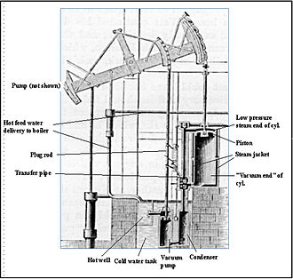
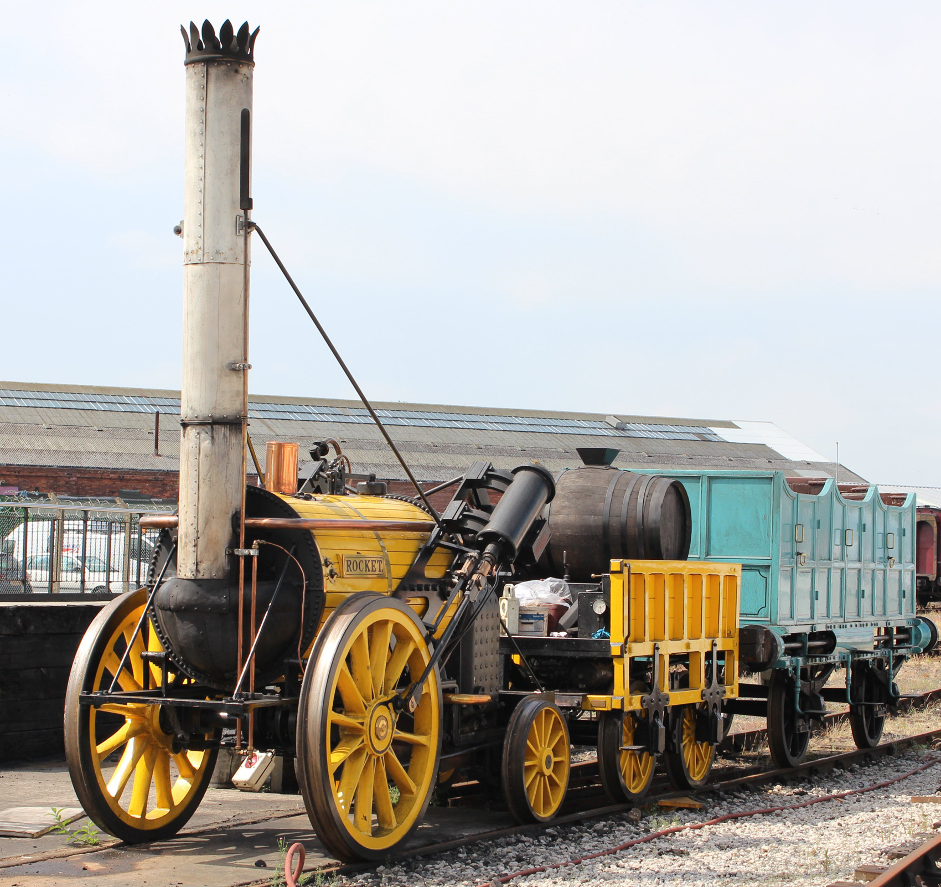
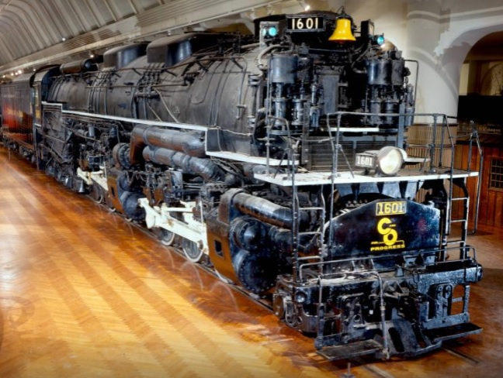
What is Machine Learning?
1770’s:
Watt’s stationary engine
ML era: late 2000s / early 2010s
1829:
Stephenson’s Rocket
ML era: 2019
1941:
Alleghany locomotive
ML era: 5-10 years from now?
Notes:
Robert H. Thurston - Thurston Robert H: History of the Growth of the Steam engine, D. Appleton & Co 1878 WATTS
Rocket reconstruction: https://www.american-rails.com/stephensons-rocket.html#gallery[pageGallery]/4/
Alleghany locomotive: https://www.thehenryford.org/collections-and-research/digital-collections/artifact/9628#slide=gs-187634
- Pulled from service after only 11 years

Slide 4
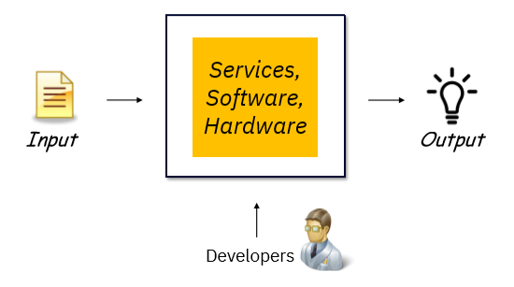
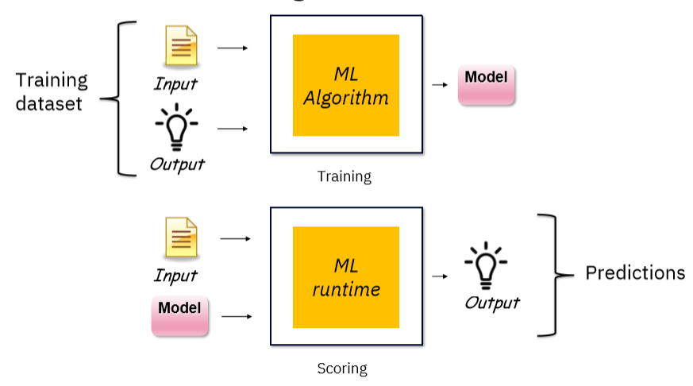
What is Machine Learning?
Classical Programming
Machine Learning
Notes:
Classical Programming:
Data is processed through code that is created by a developer to produce an output.
The behaviour of the code may depend on the input data, but the code itself is immutable (with the exception of overloading functions to have different behaviour based on the type of the argument with which it is called – but even there the developer explicitly specified the behaviour)
Machine Learning
The code organizes itself, determines its behaviour relative to input it sees when it is deployed, based on the data it has seen in the training phase.
By showing the ML algorithm the input and the actual output (for example, the number of rooms and square footage of houses, along with their selling prices), you get a trained model
Once you have a trained model, you feed it and (new) input data into the ML runtime to get predictions
You still have coding to do with machine learning – you will see some of the steps it takes to prepare data to train a model, and ML algorithms are still picky about what kind of data they can be trained with – but the lines of code where the model is trained can:
Very short
Boilerplate
There are aspects of getting value out of machine learning applications that are different than classical programming:
Tracking model accuracy – assessing whether the model continues to make accurate predictions on new data
Retraining – updating models to ensure that accuracy standards are maintained

Slide 5
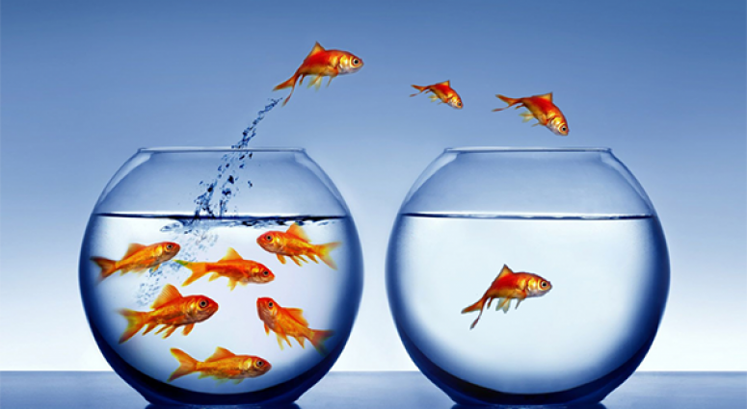
Customer churn: use case to illustrate machine learning
Customer churn: when a customer ends their relationship with a business
PROBLEM: You need to predict which of your customers are loyal and which are at risk of churning
SOLUTION: Use data you have about clients to build a model that can predict whether a given client is going to churn

Slide 6
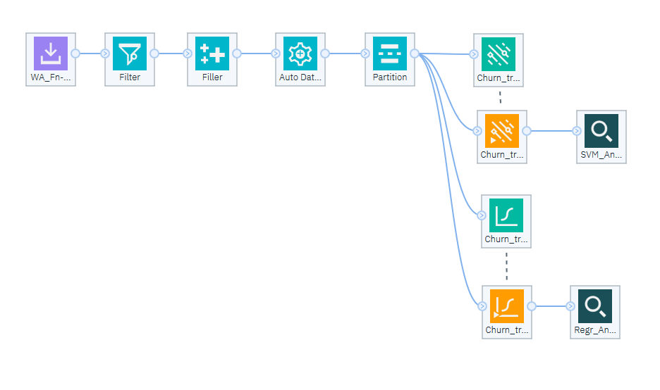
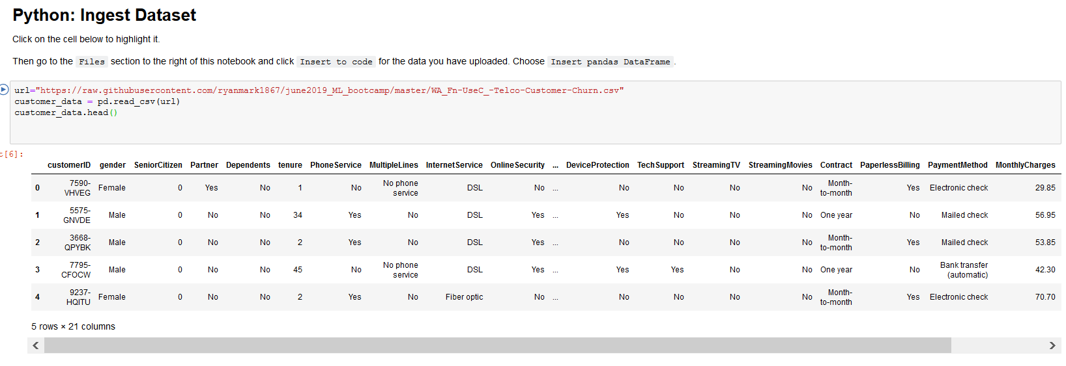
Customer Churn: the game plan
1
Solve the customer churn problem using Modeler
2
Solve the customer churn problem using Python

Slide 7
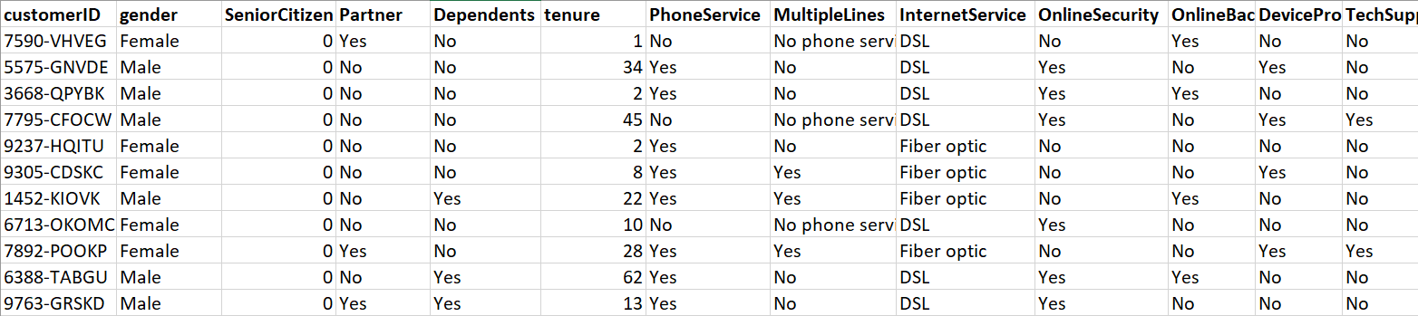
Customer churn: dataset
CSV (comma separated values) file with ~7k records; 21 columns
Numeric columns: tenure, MonthlyCharges, TotalCharges
Categorical columns: gender, SeniorCitizen, Partner...
Target / Label: Churn

Slide 8
Customer churn: preparing the dataset for ML
Original dataset
Why?
Keep a subset of columns
Pick just the columns needed for the model
Deal with missing values
ML algorithms need numeric input
Deal with outliers
Scale continuous values
Deal with string values
Control impact of anomalies
Consistent impact of columns
ML algorithms need numeric input
Split Dataset into Train & Test
Need to reserve a portion of the data the model has never seen to validate the model

Slide 9
Customer churn: preparing the dataset for ML
Original dataset
Keep a subset of columns
Pick the 8 columns needed for the model:
tenure
InternetService
OnlineSecurity
Contract
PaymentMethod
MonthlyCharges
TotalCharges
Churn
Deal with missing values
Deal with outliers
Scale continuous values
Deal with string values
Split Dataset into Train & Test

Slide 10

Machine learning models: Logistic Regression
Classification: churn / no churn
Extension of linear regression
simplest algorithm; used to predict continuous values
e.g. predict house price from # of bedrooms, sq. ft, frontage
Logistic regression is “geared” to output between 0 and 1
treat 0.5 as the boundary
With X (input) and Y (outcome):
Define function: Ŷ = aX + b
Ŷ is the prediction (churn)
X (tenure, InternetService, etc) is the input; a is the weights; b is the offset
Notes:
Logistic regression models the probabilities for classification problems with two possible outcomes. It’s an extension of the linear regression model for classification problems.
Instead of fitting a straight line or hyperplane, the logistic regression model uses the logistic function to squeeze the output of a linear equation between 0 and 1. The logistic function is defined as:
logistic(η)=11+exp(−η)
https://christophm.github.io/interpretable-ml-book/logistic.html
An adaptation of linear regression
Linear regression: https://christophm.github.io/interpretable-ml-book/limo.html#limo
Implementation of linear regression:
https://towardsdatascience.com/linear-regression-using-gradient-descent-97a6c8700931
Y = Mx + c
Gradient descent is an iterative optimization algorithm to find the minimum of a function. Here that function is our Loss Function.

Slide 11

Machine learning models: the secret sauce
Define a loss function (delta between predictions and actual values):
Ŷ vs. Y
Repeatedly update a (weights) and c (offset) using the loss function:
Calculate the partial derivative of the loss function with respect to the weight and offset
Update the weight and offset by their respective partial derivatives
Making updates to the weights based on “the slope” of the loss function will reduce the loss function -> increase the accuracy of the prediction
Notes:
Logistic regression models the probabilities for classification problems with two possible outcomes. It’s an extension of the linear regression model for classification problems.
Instead of fitting a straight line or hyperplane, the logistic regression model uses the logistic function to squeeze the output of a linear equation between 0 and 1. The logistic function is defined as:
logistic(η)=11+exp(−η)
https://christophm.github.io/interpretable-ml-book/logistic.html
An adaptation of linear regression
Linear regression: https://christophm.github.io/interpretable-ml-book/limo.html#limo
Implementation of linear regression:
https://towardsdatascience.com/linear-regression-using-gradient-descent-97a6c8700931
Y = Mx + c
Gradient descent is an iterative optimization algorithm to find the minimum of a function. Here that function is our Loss Function.

Slide 12
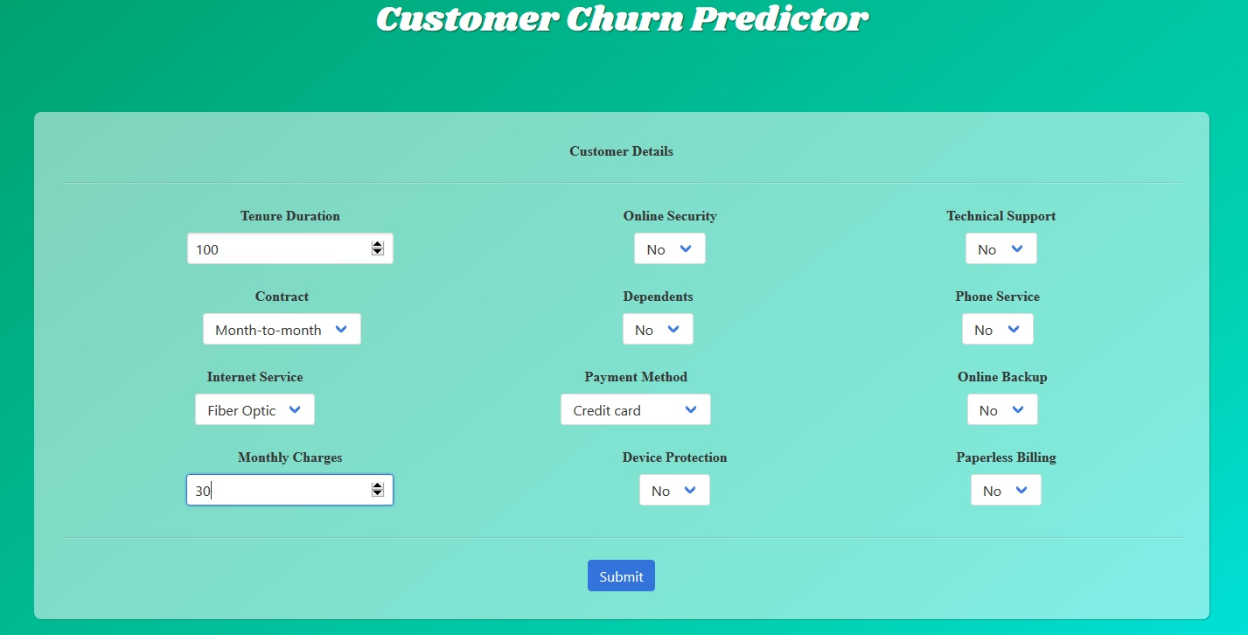
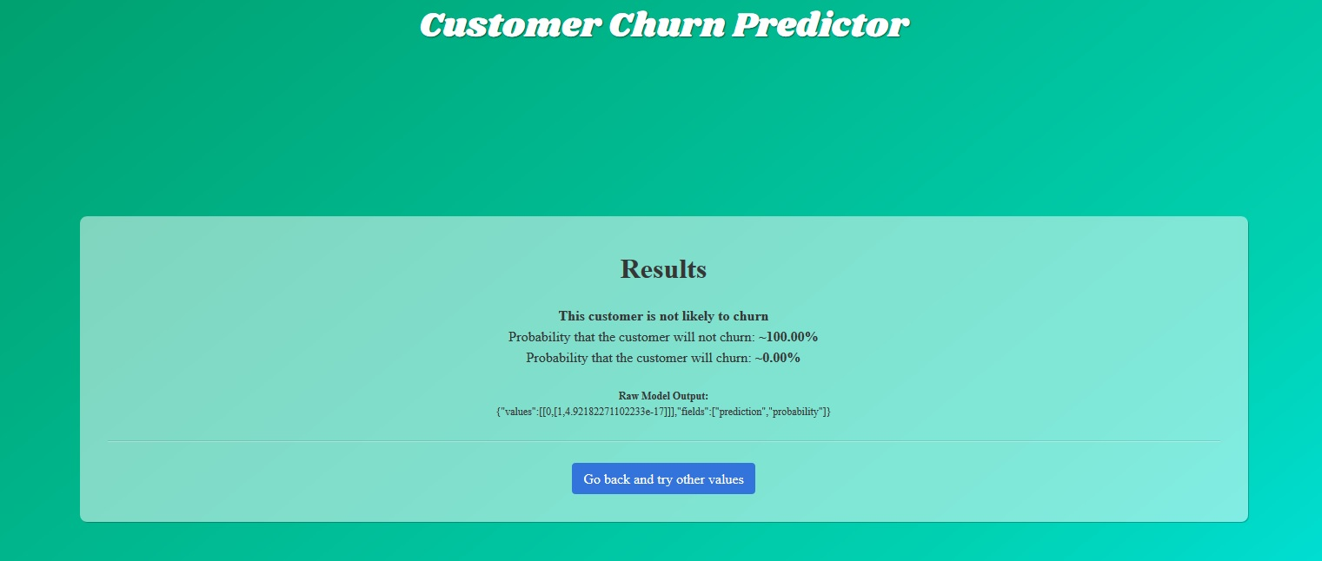
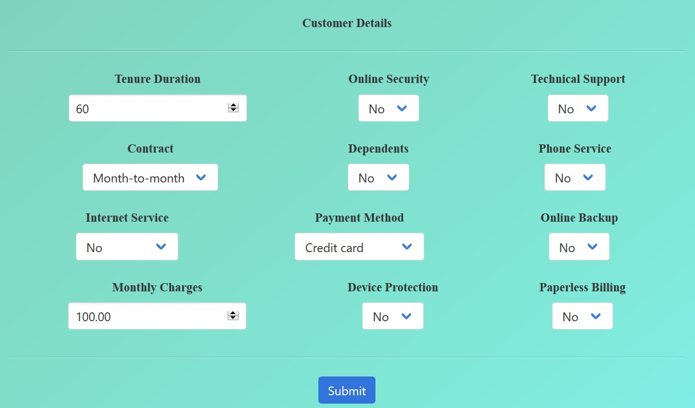
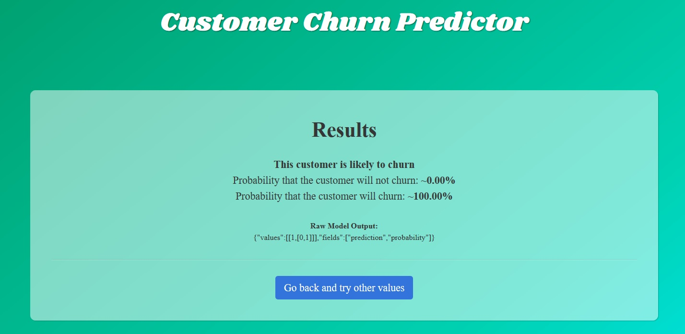
Customer churn: exercising the model
Using the full-blown Python project, you can deploy and exercise the model:
Notes:
Logistic regression models the probabilities for classification problems with two possible outcomes. It’s an extension of the linear regression model for classification problems.
Instead of fitting a straight line or hyperplane, the logistic regression model uses the logistic function to squeeze the output of a linear equation between 0 and 1. The logistic function is defined as:
logistic(η)=11+exp(−η)
https://christophm.github.io/interpretable-ml-book/logistic.html
An adaptation of linear regression
Linear regression: https://christophm.github.io/interpretable-ml-book/limo.html#limo
Implementation of linear regression:
https://towardsdatascience.com/linear-regression-using-gradient-descent-97a6c8700931
Y = Mx + c
Gradient descent is an iterative optimization algorithm to find the minimum of a function. Here that function is our Loss Function.

Slide 13
®

Slide 14
Color palette
R-0 G-0 B-0
R-110 G-23 B-125
R-0 G-15 B-94
R-255 G-255 B-255
R-110 G-23 B-125
R-0 G-15 B-94
R-234 G-234 B-234
R-31 G-179 B-207
R-0 G-59 B-201
R-234 G-234 B-234
R-31 G-179 B-207
R-0 G-59 B-201
R-219 G-38 B-99
R-105 G-166 B-255
R-0 G-100 B-255
R-219 G-38 B-99
R-105 G-166 B-255
R-0 G-100 B-255

